Slide 1


BUDGE-BUDGE INSTITUTE OF TECHNOLOGY
JULY 2021
PROJECT PRESENTATION
Bengali and Hindi Signature Verification using Convolution Siamese Network
PRESENTED BY: ARPITA HALDER
Supervisor: Prof Bimal Datta
Department: Computer Science and Engineering
Roll no. 27600117072

Slide 2
Objective
Motivation
Literature Survey
Problem
Solution
Methodology
Dataset Used
Architecture
Result and Discussion
Hardware and Software Requirements
Conclusion
Areas of Improvement
Project GitHub Link
Outline
BUDGE-BUDGE INSTITUTE OF TECHNOLOGY
july 2021

Slide 3

Objective
Verification of off-line signatures is one of the most challenging tasks in biometrics and document forensic science. In this project,we deal with Convolutional Siamese Network model which is capable of doing verification of Bengali and Hindi Signature.

Slide 4
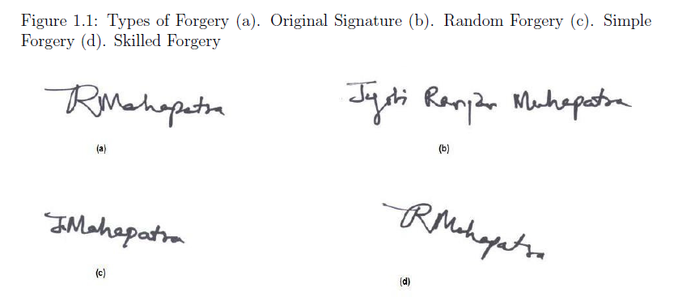
Growing need for a full proof signature verification scheme which can guarantee maximum possible security from fake signatures.
Motivation
The problem with signature is very complex because of subtle variations in writing styles independent of scripts, which could also encapsulate some degrees of forgery.
Therefore my motivation was to mine this ultra fine anamorphosis and create a generic model.

Slide 5
01
R. Plamondon, S. Srihari, Online and offline handwriting recognition: a comprehensive survey
02
SigNet: Convolutional Siamese Network for Writer Independent Online Signature
Verification
Literature Survey
From Blogs and Research Papers
03
Siamese networks with Keras, TensorFlow, and Deep Learning
https://www.pyimagesearch.com/2020/11/30/siamese-networks-with-keras-tensorflow-and-deep-learning/
04
Automated Signature Verification Using Siamese Network
https://medium.datadriveninvestor.com/automated-signature-verification-using-siamese-network-87f3a2f55f2e

Slide 6

Problem
WHAT WE WANT TO SOLVE
To predict a finite number of classes we can train any deep CNN classifier but classes need to be pre-defined and a huge size of dataset is required to the task.

Slide 7
Solution
Why Siamese Neural Network?
WHAT WE WANT TO ACHIEVE
Ability to generalize to new classes that it has not been trained on, and in fact, the number of classes that it is expected to support does not have to be known at training time
The architecture needs less data for training purpose

Slide 8
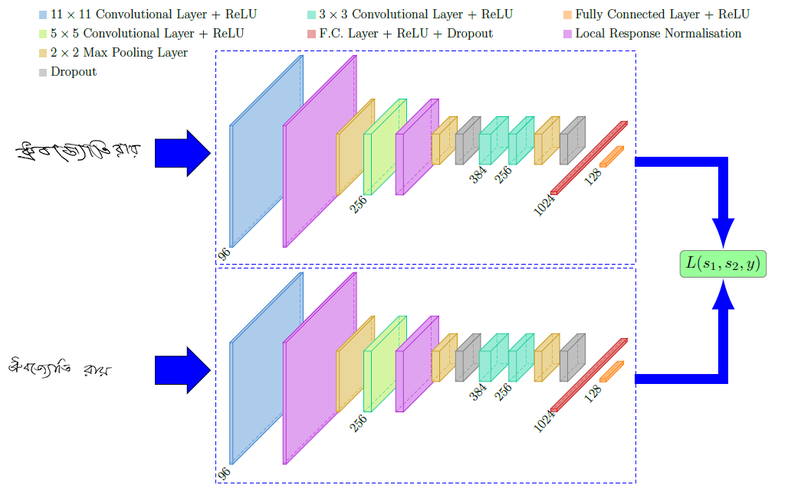
Methodology

Slide 9
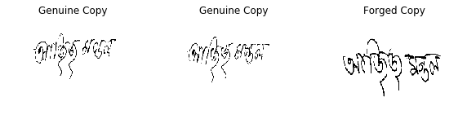
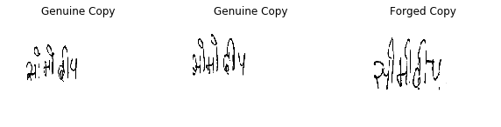
Dataset Used
Bengali
Hindi

Slide 10

Each set consists of 24 genuine signatures and 30 skilled forgeries.
Therefore, A total number of 6240 genuine and 7800 skilled forgery signatures were collected from all 260 individuals.
Bengali
100 classes
1.4 GB Total File size
Hindi
160 classes
2.25 GB Total File size
The dataset is available at https://goo.gl/9QfByd

Slide 11
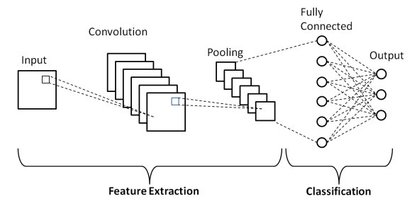
What is CNN or Convolutional Neural Network ?

Slide 12
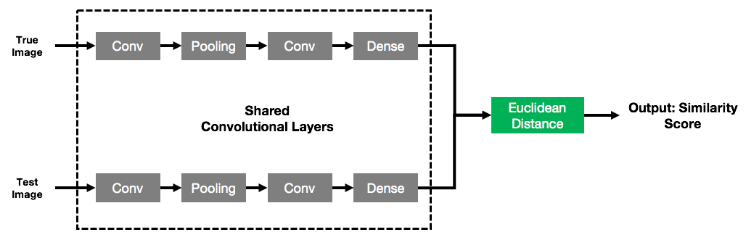
Siamese Neural Network
Siamese neural network is a class of network architectures that usually contains two identical subnetworks. The twin CNNs have the same configuration with the same parameters and shared weights. The parameter updating is mirrored across both the subnetworks.

Slide 13
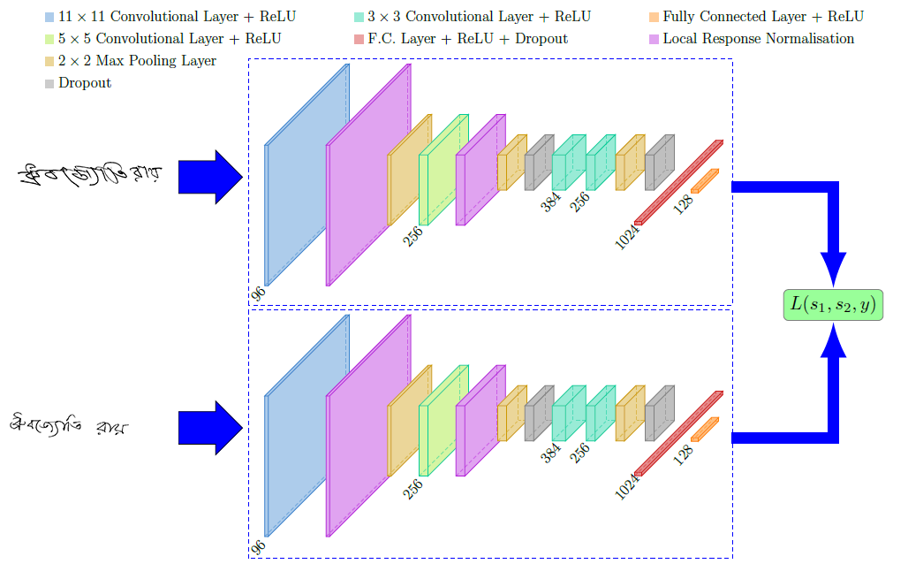
Architecture

Slide 14
Result and Discussion

Slide 15

Performance Matrics
DESCRIPTIVE OUTCOMES OF THE STUDY
False Acceptance Rate (FAR): the percentage of identification instances in which unauthorized persons are incorrectly accepted.
All imposter scores = FP+TN
FAR = FP/(FP+TN)
False Rejection Rate (FRR): the percentage of identification instances in which authorized persons are incorrectly rejected.
All genuine scores = TP+FN
FRR = FNR = FN/(TP+FN)
Here, FP: False positive, FN: False Negative, FN: True Negative and TP: True Positive

Slide 16
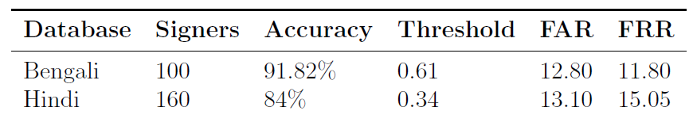

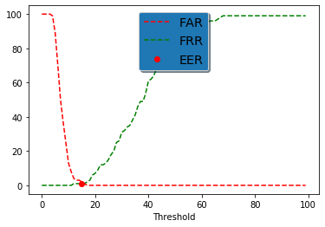
Result of the study

Slide 17
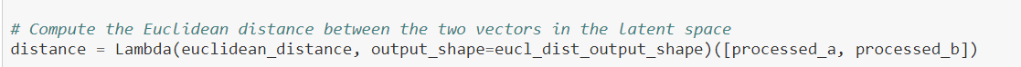
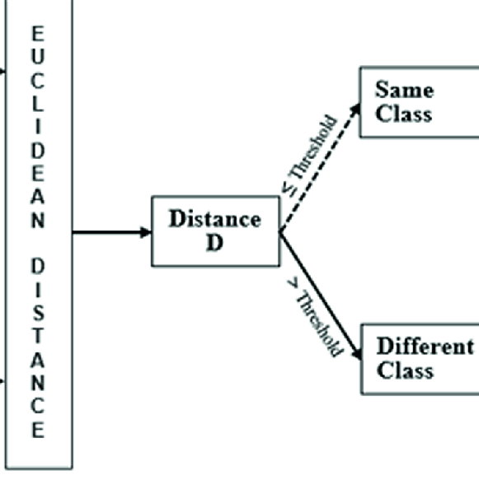
Euclidean Distance
If the two pictures are from the same class, the distance should be “low”, if the pictures are from different classes, the distance should be “high”. So we need a threshold: if the found distance is under the threshold then it's a “same” decision, if the distance is above the threshold then it's a “different” decision.

Slide 18
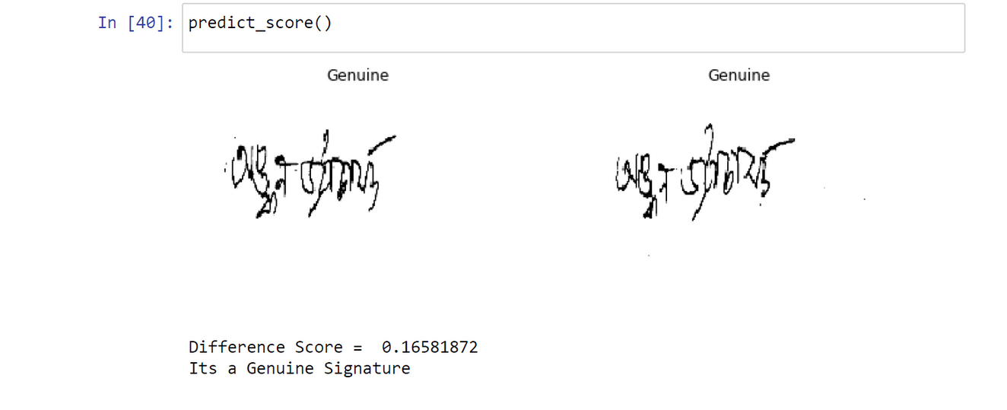

Result for Bengali Dataset
The difference score is less than threshold. Hence, Genuine Signature
The difference score is more than threshold. Hence, Forged Signature.

Slide 19
Hardware and Software Requirements
Our entire framework is implemented using Keras library with the TensorFlow as backend. The training was done using Jupyter Notebook and CPU, and it took about 12 hours approximately, depending on different databases.

Slide 20

Conclusion
In this project, we have presented a framework based on Siamese network for offline signature verification, which uses writer independent feature learning.
Our experiments made on cross domain datasets emphasize how well our architecture models the fraudulence of different handwriting style of different signers and forgers with diverse background and scripts.

Slide 21
Areas of improvement
SUGGESTIONS FOR FUTURE RESEARCH
In future, more regional languages such as Tamil, Telugu, Malayalam etc can be implemented for signature verification.
Training data having complex writing style can be used to develop a more enriched network for better verification.
Better network can be designed to reduce training time.
Efficiency of the current model can be improved by tweaking parameters and formulating a better loss function.
BUDGE-BUDGE INSTITUTE OF TECHNOLOGY
JULY 2021

Slide 22

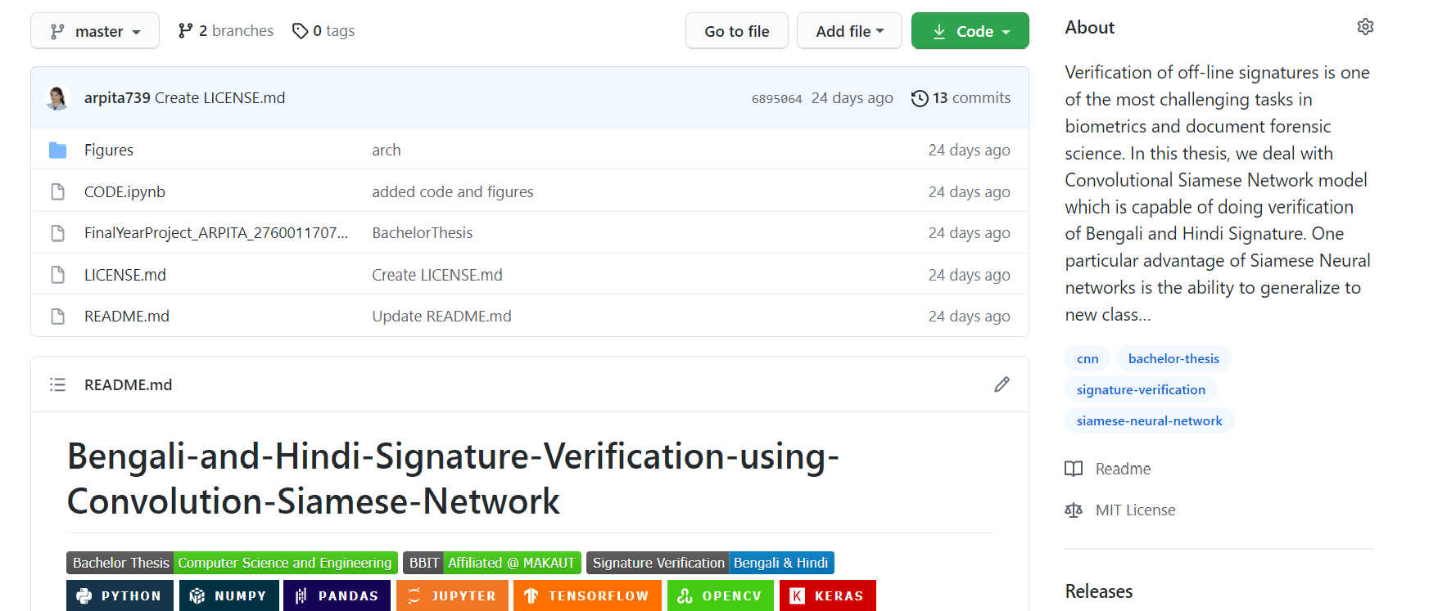
https://github.com/arpita739/Bengali-and-Hindi-Signature-Verification-using-Convolution-Siamese-Network

Slide 23
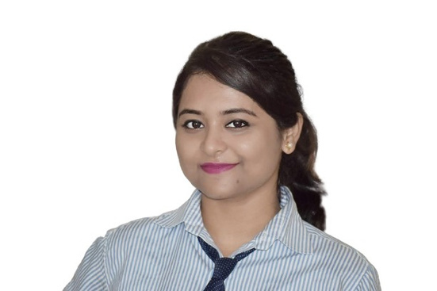

BUDGE-BUDGE INSTITUTE OF TECHNOLOGY
JULY 2021
THANK YOU
ARPITA HALDER
CSE DEPARTMENT
4TH YEAR
https://www.linkedin.com/in/arpita-halder-8718b413b/

